Slide 1
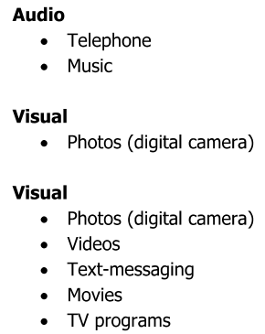
Mobile Devices Features of Mobile Devices

Slide 2
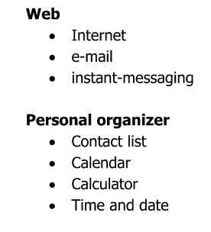
Features of Mobile Devices (cont’d)

Slide 3
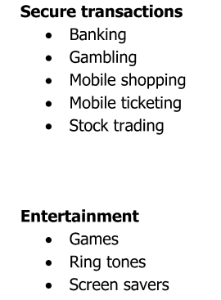
Mobile Device Features (cont’d)

Slide 4
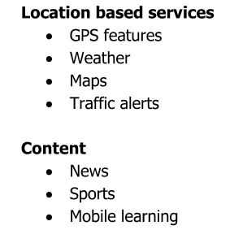
Mobile Device Features (cont’d)

Slide 5
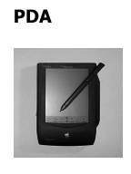

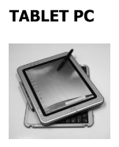
Mobile Devices

Slide 6
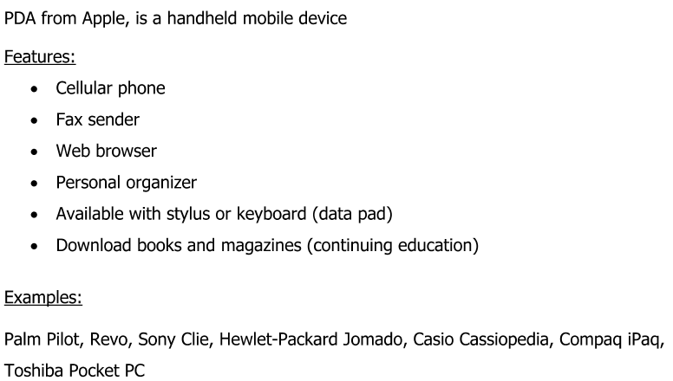
PDA

Slide 7

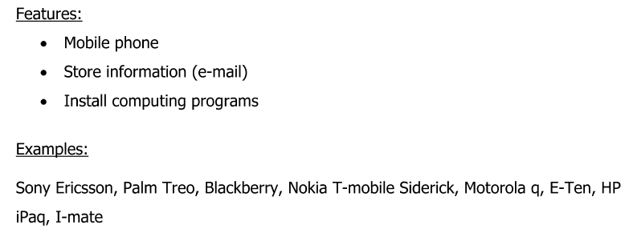

Slide 8
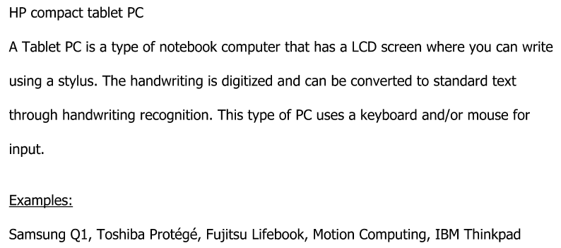
Tablet PC

Slide 9

Mobile Operating Systems

Slide 10
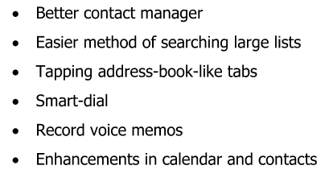
Features of Some Mobile OS

Slide 11
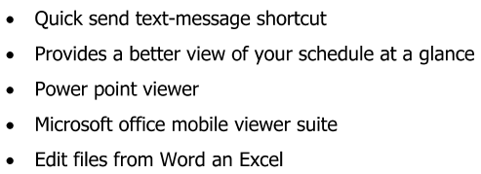
Features of Some Mobile OS (cont’d)

Slide 12
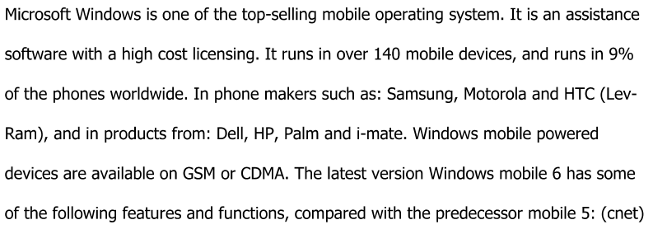
MS Windows

Slide 13
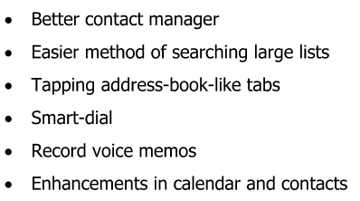
Features and Functions of Windows

Slide 14
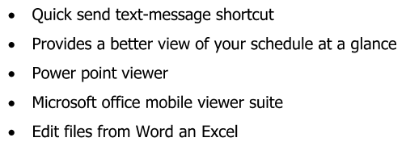
Features and Functions of Windows (cont’d)

Slide 15

Symbian

Slide 16

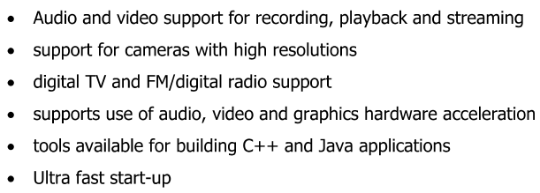
Symbian

Slide 17

Mac OS X

Slide 18
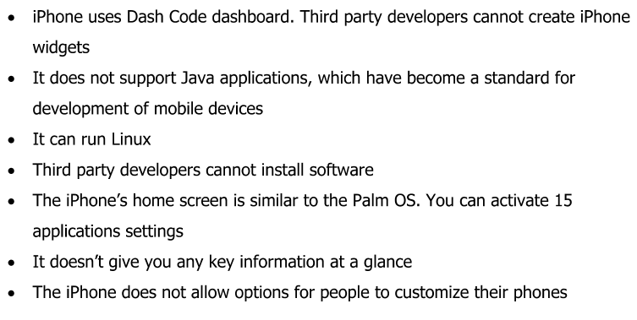
Features of Mac OS

Slide 19

Features of Mac OS (cont’d)

Slide 20

Other Features of Mac OS

Slide 21
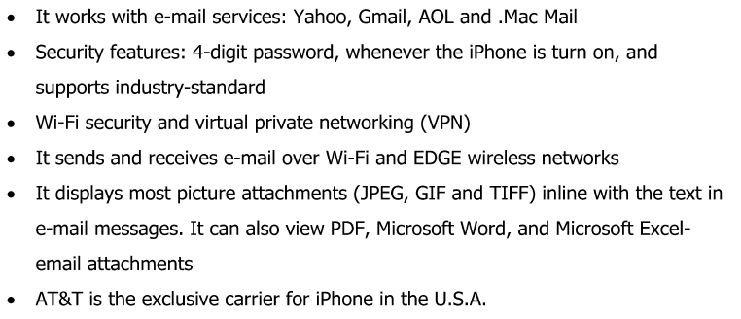
Other Features of Mac OS (cont’d)

Slide 22


Linux OS

Slide 23

Palm OS

Slide 24


Android

Slide 25
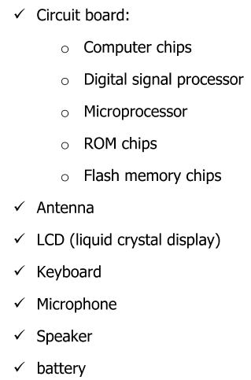
Parts of a Cellular Phone

Slide 26
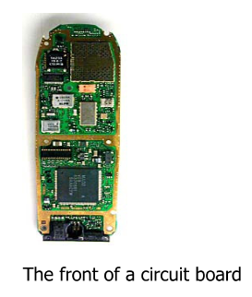
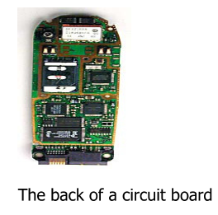
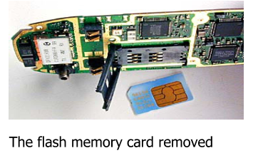
Cellular Phone Circuit Board

Slide 27
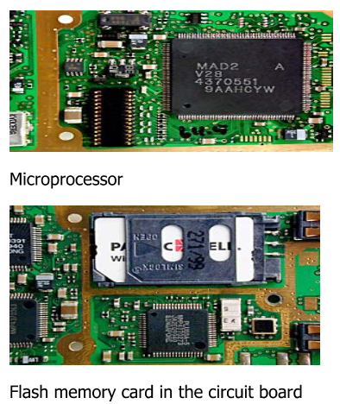
Cellular Phone Circuit Board (cont’d)

Slide 28
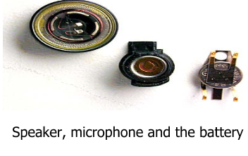
Other Cellular Phone Components

